Slide 1
Experimental Design within Serious Games - Overview
Summer 2021
Notes:
1
1
Check distro statement before using:
DISTRIBUTION STATEMENT A. Approved for pubic release: distribution is unlimited.
This material is based upon work supported under Air Force Contract No. FA8721-05-C-0002 and/or FA8702-15-D-0001. Any opinions, findings, conclusions or recommendations expressed in this material are those of the author(s) and do not necessarily reflect the views of the U.S. Air Force.
© 2021 Massachusetts Institute of Technology.
Delivered to the U.S. Government with Unlimited Rights, as defined in DFARS Part 252.227-7013 or 7014 (Feb 2014). Notwithstanding any copyright notice, U.S. Government rights in this work are defined by DFARS 252.227-7013 or DFARS 252.227-7014 as detailed above. Use of this work other than as specifically authorized by the U.S. Government may violate any copyrights that exist in this work.

Slide 2
Overview
Research Methods
Experimental Design Process
Design of Experiments (DOE)
DOE Basics
DOE Terminology
Data Analysis
Basic Statistical Tests
What test to use?
Example: Caffeine!
Will I use this in the course?
Notes:
https://ocw.mit.edu/courses/aeronautics-and-astronautics/16-422-human-supervisory-control-of-automated-systems-spring-2004/lecture-notes/040604coop_decis.pdf

Slide 3
Research Methods
Qualitative vs. Quantitative
Understanding the relationship between objectives (research question) and variables is critical
Information ≠ Data
Information = data + analysis
Planning in advance is a must
Includes how data will be analyzed
Notes:
https://ocw.mit.edu/courses/aeronautics-and-astronautics/16-422-human-supervisory-control-of-automated-systems-spring-2004/lecture-notes/040604coop_decis.pdf

Slide 4
Research Methods
Social and cultural phenomenon
Case studies
Focus groups
Observational
Usability testing
Can be both qualitative and quantitative
Interviews
Questionnaires
Notes:
https://ocw.mit.edu/courses/aeronautics-and-astronautics/16-422-human-supervisory-control-of-automated-systems-spring-2004/lecture-notes/040604coop_decis.pdf

Slide 5
Quantitative Research Methods
Natural phenomenon
Mathematical modeling
Experiments
Optimization
Game theory
Surveys
Bottom line – statistics are a must
Notes:
https://ocw.mit.edu/courses/aeronautics-and-astronautics/16-422-human-supervisory-control-of-automated-systems-spring-2004/lecture-notes/040604coop_decis.pdf

Slide 6
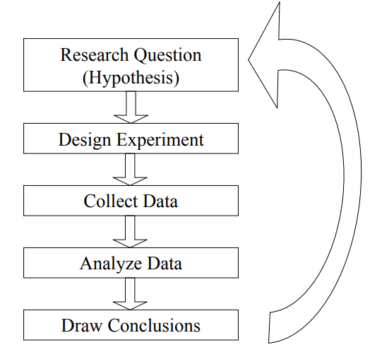
Experimental Design Process
Notes:
https://ocw.mit.edu/courses/aeronautics-and-astronautics/16-422-human-supervisory-control-of-automated-systems-spring-2004/lecture-notes/040604coop_decis.pdf

Slide 7
Design of Experiments (DOE)
Design of Experiments (DOE) defined:
A theory concerning the minimum number of experiments necessary to develop an empirical model of a research question and a methodology for setting up the necessary experiments.
Human subject vs. object experimentation
Other DOE Constraints
Time
Money
Notes:
https://ocw.mit.edu/courses/aeronautics-and-astronautics/16-422-human-supervisory-control-of-automated-systems-spring-2004/lecture-notes/040604coop_decis.pdf

Slide 8
DOE Basics
Two kinds of data gathering methodologies
Observation
Can’t prove cause & effect but can establish associations
Subject to human bias
Experimental
Cause & effect
Variables of interest – factors vs. treatments
Independent variable
Treatment – manipulations of variables of interest
Treatment vs. control group
Dependent variable is what you are measuring
Notes:
https://ocw.mit.edu/courses/aeronautics-and-astronautics/16-422-human-supervisory-control-of-automated-systems-spring-2004/lecture-notes/040604coop_decis.pdf

Slide 9
DOE Basics
Confounders
Randomization Concerns
Randomization prevents experimental bias
Assignment by experimenter
Counterbalancing
Statistical assumptions
A requirement for statistical tests of significance
Why would you use the observation methodology instead of experiments?
Notes:
https://ocw.mit.edu/courses/aeronautics-and-astronautics/16-422-human-supervisory-control-of-automated-systems-spring-2004/lecture-notes/040604coop_decis.pdf

Slide 10
DOE Terminology
Replications
Independent observations of a single treatment
Variance
The measuring stick that compares different treatments
Internal validity
The extent to which an experiment accomplishes its goal(s)
Reproducibility
Given the appropriate information, the ability of others to replicate the experiment
Notes:
https://ocw.mit.edu/courses/aeronautics-and-astronautics/16-422-human-supervisory-control-of-automated-systems-spring-2004/lecture-notes/040604coop_decis.pdf

Slide 11
DOE Terminology
External validity
How representative of the target population is the sample?
Can the results be generalized?
Generalizations for field experiments are easier to justify than lab experiments because of artificialities.
Medical Trials
Placebo
Double Blind
Notes:
https://ocw.mit.edu/courses/aeronautics-and-astronautics/16-422-human-supervisory-control-of-automated-systems-spring-2004/lecture-notes/040604coop_decis.pdf

Slide 12
Data Analysis
Data Types
Variables
Categorical
Numerical
Scales of Measurement
Nominal
Ordinal
Interval
Computer Programs
Statistical libraries and packages (recommended)
Write your own (less recommended)
Notes:
https://ocw.mit.edu/courses/aeronautics-and-astronautics/16-422-human-supervisory-control-of-automated-systems-spring-2004/lecture-notes/040604coop_decis.pdf

Slide 13
Basic Statistical Tests
Assumptions for comparison of means
Independent & random
Normality
Variances roughly equal
t-tests
One or two samples
Chi-square tests
NID(0,1)
Categorical data, non-parametric
Notes:
https://ocw.mit.edu/courses/aeronautics-and-astronautics/16-422-human-supervisory-control-of-automated-systems-spring-2004/lecture-notes/040604coop_decis.pdf

Slide 14
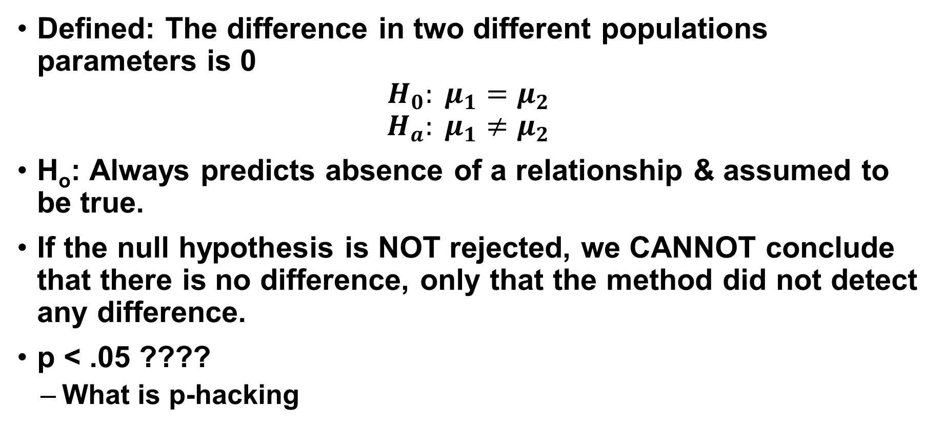
Basic Statistical Tests
Defined: The difference in two different populations parameters is 0
$$H_{0}: μ_{1}=μ_{2}$$
$$H_{a}: μ_{1}≠μ_{2}$$
H_{o}: Always predicts absence of a relationship & assumed to be true.
If the null hypothesis is NOT rejected, we CANNOT conclude that there is no difference, only that the method did not detect any difference.
p < .05 ????
What is p-hacking
Notes:
https://ocw.mit.edu/courses/aeronautics-and-astronautics/16-422-human-supervisory-control-of-automated-systems-spring-2004/lecture-notes/040604coop_decis.pdf

Slide 15
Basic Statistical Tests
Analysis of variances (ANOVA)
Testing the differences between two or more independent means (or groups) on one dependent measure (either a single or multiple independent variables).
One way vs. factorial
F test – ratio of variances
MANOVA
Notes:
https://ocw.mit.edu/courses/aeronautics-and-astronautics/16-422-human-supervisory-control-of-automated-systems-spring-2004/lecture-notes/040604coop_decis.pdf

Slide 16
Basic Statistical Tests: Non-Parametric Tests
Use when you have no good information about an underlying distribution
Parametric tests:
Parametric form - parameters either assumed to be known or estimated from the data
The mean and variance of a normal distribution
Null hypothesis can be stated in terms of parameters and the test statistic follows a known distribution.
Non-parametric tests are still hypothesis tests, but they look at the overall distribution instead of a single parameter
Particularly useful for small samples
Notes:
https://ocw.mit.edu/courses/aeronautics-and-astronautics/16-422-human-supervisory-control-of-automated-systems-spring-2004/lecture-notes/040604coop_decis.pdf

Slide 17
Basic Statistical Tests
Parametric
Correlation & Association
Pearson
T-tests
Independent & dependent
ANOVA
Factorial
Repeated measures
MANOVA
Linear regression
Non-parametric
Association
Spearman
Chi-Square
Contingency tables
Kruskal-Wallis test
Sign-test
Friedman ANOVA
Logistic regression
Notes:
https://ocw.mit.edu/courses/aeronautics-and-astronautics/16-422-human-supervisory-control-of-automated-systems-spring-2004/lecture-notes/040604coop_decis.pdf

Slide 18
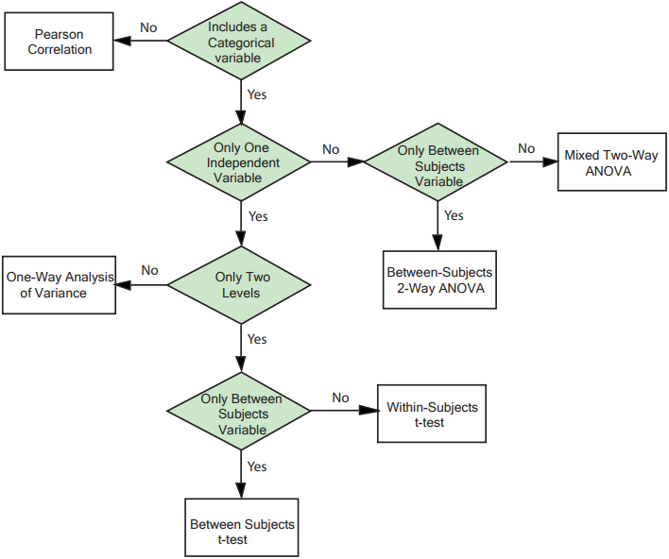
What test to use?
Notes:
https://ocw.mit.edu/courses/aeronautics-and-astronautics/16-422-human-supervisory-control-of-automated-systems-spring-2004/lecture-notes/040604coop_decis.pdf
Figure: Adapted from University of Maryland Psychology World

Slide 19
Example: Caffeine!
Does drinking cappuccino one hour before a test improve results?
What is the metric (dependent variable)?
Experimental Design
Treatment group vs. control group
A single comparison
Experimental efficiency
Perhaps we want to look at who makes the cappuccino (Dunkin’, Starbucks, Pete’s) as well as the difference between coffee and cappuccino.
6! ☹ (2x3 Factorial)
Interaction effects
Notes:
https://ocw.mit.edu/courses/aeronautics-and-astronautics/16-422-human-supervisory-control-of-automated-systems-spring-2004/lecture-notes/040604coop_decis.pdf

Slide 20
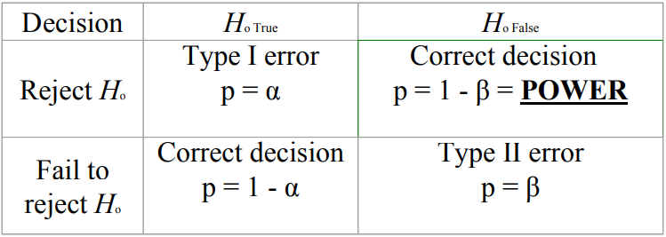
Example: Caffeine!
How many subjects do we need?
Sample Size
Related to power – the complement of a Type II error…
Notes:
https://ocw.mit.edu/courses/aeronautics-and-astronautics/16-422-human-supervisory-control-of-automated-systems-spring-2004/lecture-notes/040604coop_decis.pdf

Slide 21
Example: Caffeine!
So how do you determine sample size?
General idea, work backwards from statistical test
https://clincalc.com/stats/samplesize.aspx
# of factors influences sample size
Recruitment Issues
Population selection
How do we assign subjects to treatment categories?
Confounds
Experience
Self-selection
Control techniques
Notes:
https://ocw.mit.edu/courses/aeronautics-and-astronautics/16-422-human-supervisory-control-of-automated-systems-spring-2004/lecture-notes/040604coop_decis.pdf

Slide 22
Example: Caffeine!
What is the most efficient way to use human subjects?
Between subjects
Within subjects
Repeated measures
Increases power but…
Confounds – practice & fatigue
Counterbalance
Mixed subjects
Pre-test/post-test
Tests over time
Notes:
https://ocw.mit.edu/courses/aeronautics-and-astronautics/16-422-human-supervisory-control-of-automated-systems-spring-2004/lecture-notes/040604coop_decis.pdf

Slide 23
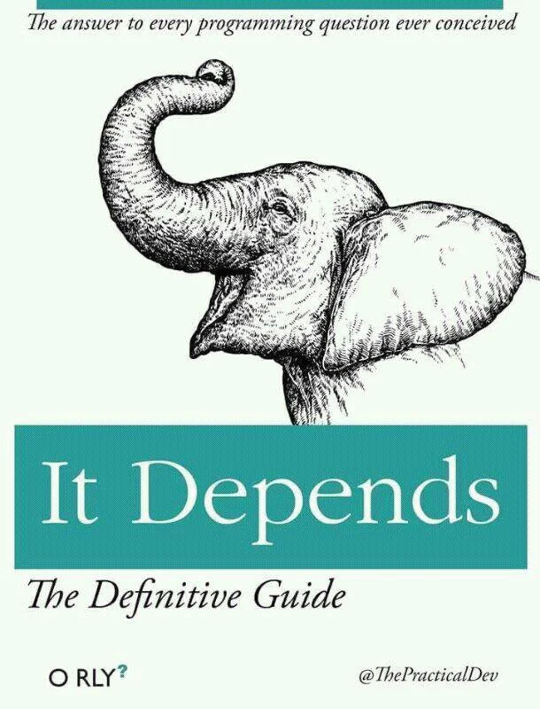
Will I use this in the course?
Notes:
https://ocw.mit.edu/courses/aeronautics-and-astronautics/16-422-human-supervisory-control-of-automated-systems-spring-2004/lecture-notes/040604coop_decis.pdf

Slide 24
Take-a-Ways
Do NOT build an experiment without:
Having a hypothesis you are testing or theory you are expanding
Do NOT build a tool without:
Knowing what experiments you need to run to support it
Exploration vs Validation
There are times when a hypothesis or theory can be vague and open ended
Humans always introduce bias
Cognitive bias are always present
What are some examples?
Ethics
Internal review boards
Protect participants
Notes:
https://ocw.mit.edu/courses/aeronautics-and-astronautics/16-422-human-supervisory-control-of-automated-systems-spring-2004/lecture-notes/040604coop_decis.pdf

Slide 25
Ethics and Risks to Participants
Low Risk and relevant
Informed consent
Protected data
Social risks
Physical and psychological risks
Individual vs population risks
What are some safe guards we should employ to protect participants?
The Milgram Experiment (https://youtu.be/xOYLCy5PVgM)
Stanford Prison experiment (https://youtu.be/sZwfNs1pqG0)
The Bystander Effect (https://youtu.be/BdpdUbW8vbw)
Notes:
https://ocw.mit.edu/courses/aeronautics-and-astronautics/16-422-human-supervisory-control-of-automated-systems-spring-2004/lecture-notes/040604coop_decis.pdf

Slide 26

